Slide 1

Alvitr（アルビタ）
Web Crawler for
Member: Zifeng Su (Chimoe), Kaijian Zhong (kaijianZ), Zhengyi Shi (zerosorasky)
Github Page:https://github.com/kaijianZ/Alvitr
Notes:
In the drawing website Pixiv, the artist will sometimes delete their works after those works or set them for private. I would like to use a web crawler to retrieve the information that they ever existed in public, saving the weeaboos when they don't know where their waifu came from.

Slide 2
What Is Alvitr
This program can automatically download illustrations from
website to user’s local computer.
Current download options
Daily ranking
Specific tag

Slide 3
Goal Change
At first, Alvitr can re-distribute illustrations gathered by it. However, considering some legal risks, it is no longer a re-distributor.
Now, Alvitr only download illustrations to user’s local computer. Users can distribute these illustrations by themselves if they want.

Slide 4
What We Use
Python
MIT License
Regular expression
collect download address
Multi-thread
make it more efficient
Database
avoid duplicates

Slide 5
How To Accomplished
Daily ranking
Read date that user entered. If there is not a given date or given date is invalid, the date will be set to today;
Go through that date’s daily popular list;
Collect the pixiv_id of each illustration;
Download these illustrations by pixiv_id.
Specific tag
Read the tag that user entered;
Go throuth all illustrations that contain this tag;
Gather the pixiv_id of each illustration;
Download these illustrations by pixiv_id.

Slide 6
Demo

Slide 7
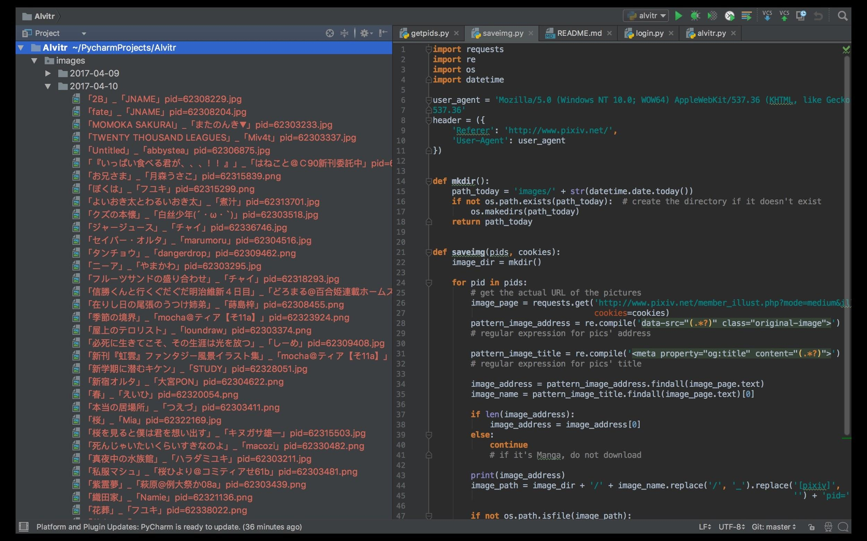

Slide 8
Future Development
There are two more download options we want to provide for users
Download by specific illustrator
Download by recommendation
Make database can work better
This program is now running on terminal, we can make a UI for it

Slide 9
THE END
Question Session

